Slide 1
ASP.NET Core

Slide 2
Contents
Middleware
Dependency Injection
Controllers
Routing

Slide 3
Middleware In Asp.Net Core
Middleware are software components that are assembled into an application pipeline to handle requests and responses.
Each component chooses whether to pass the request on to the next component in the pipeline, and can perform certain actions before and after the next component is invoked in the pipeline.
Request delegates are used to build the request pipeline. The request delegates handle each HTTP request.
Each piece of middleware in ASP.NET Core is an object, and each piece has a very specific, focused, and limited role.
Ultimately, we need many pieces of middleware for an application to behave appropriately.

Slide 4
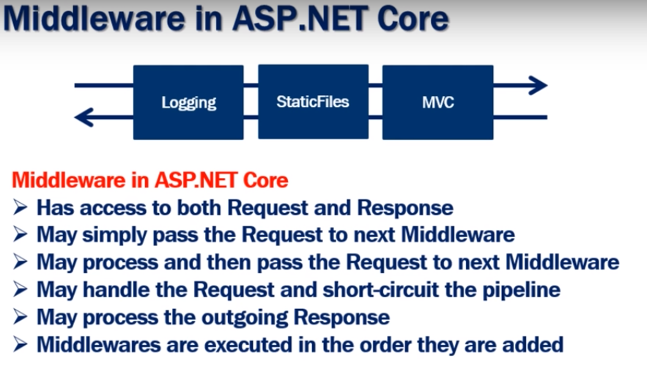

Slide 5
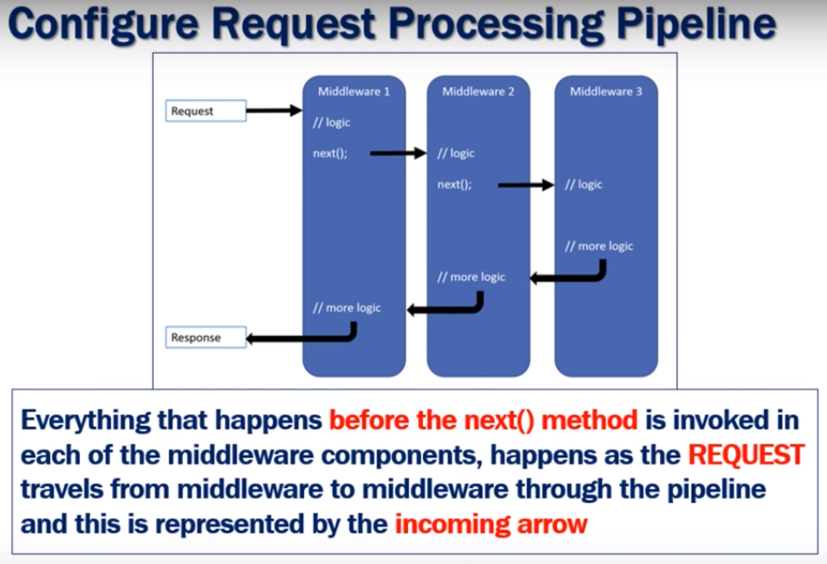

Slide 6
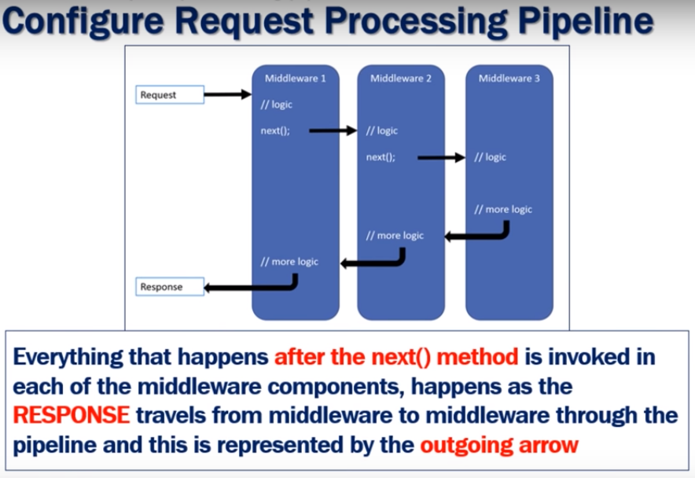

Slide 7
Dependency Injection In Asp.Net Core
Dependency Injection is the design pattern that help us to create application which loosely coupled
The main advantages of DI is our application loosely coupled and has provide greater maintainability, testability and also re-usability.
Type of DI :
Constructor Injection: With this approach, you create an instance of your dependency and pass it as an argument to the constructor of the dependent class.
Method Injection: In this case, you create an instance of your dependency and pass it to a specific method of the dependent class.
Property Injection: This approach allows you to assign the instance of your dependency to a specific property of the dependent class.

Slide 8
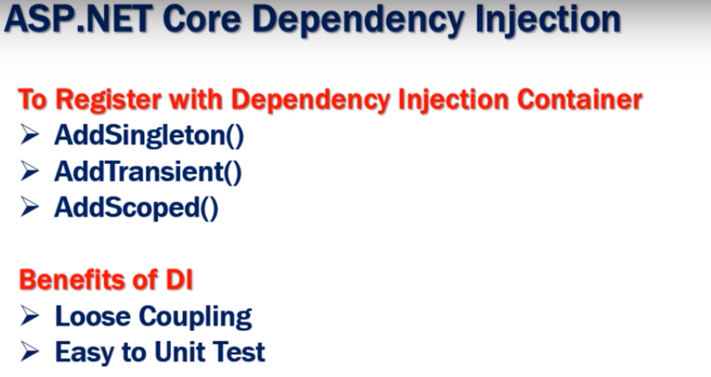

Slide 9
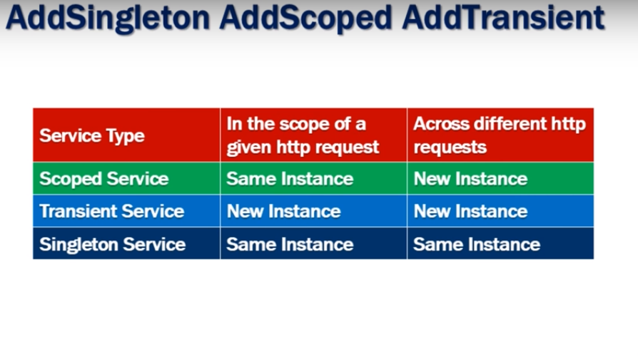

Slide 10
Controllers In Asp.Net Core
Controller handles any incoming URL request
Controller class contains public methods called Action methods. Controller and its action method handles incoming browser requests, retrieves necessary model data and returns appropriate responses.
Action method : All the public methods of the Controller class are called Action methods
Action method must be public. It cannot be private or protected
Action method cannot be overloaded
Action method cannot be a static method.

Slide 11
Routing In Asp.Net Core
Routing is the process of directing an HTTP request to a controller.
The MVC middleware will make this decision based on the URL and some configuration information we provide.
Type of Routing :
Conventional Routing:
Attribute Routing: We use C# attributes (eg : [Route(“index")] ) on our controller classes and on the methods internally in these classes.
app.UseEndpoints(endpoints => { endpoints.MapControllerRoute( name: "default",
pattern: "{controller=Home}/{action=Index}/{id?}"); });

Slide 12
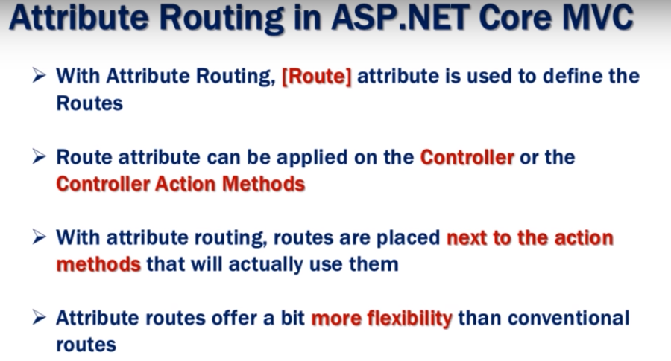

Slide 13
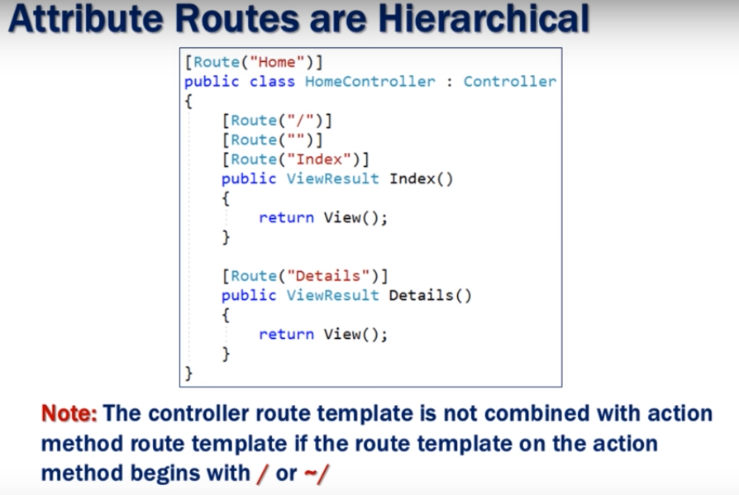

Slide 14
Thank You!

